Slide 1
Big Mountain Resort Recommendation
Prepared by: Prem Ananda
Springboard Data Science
07.12.2020

Slide 2
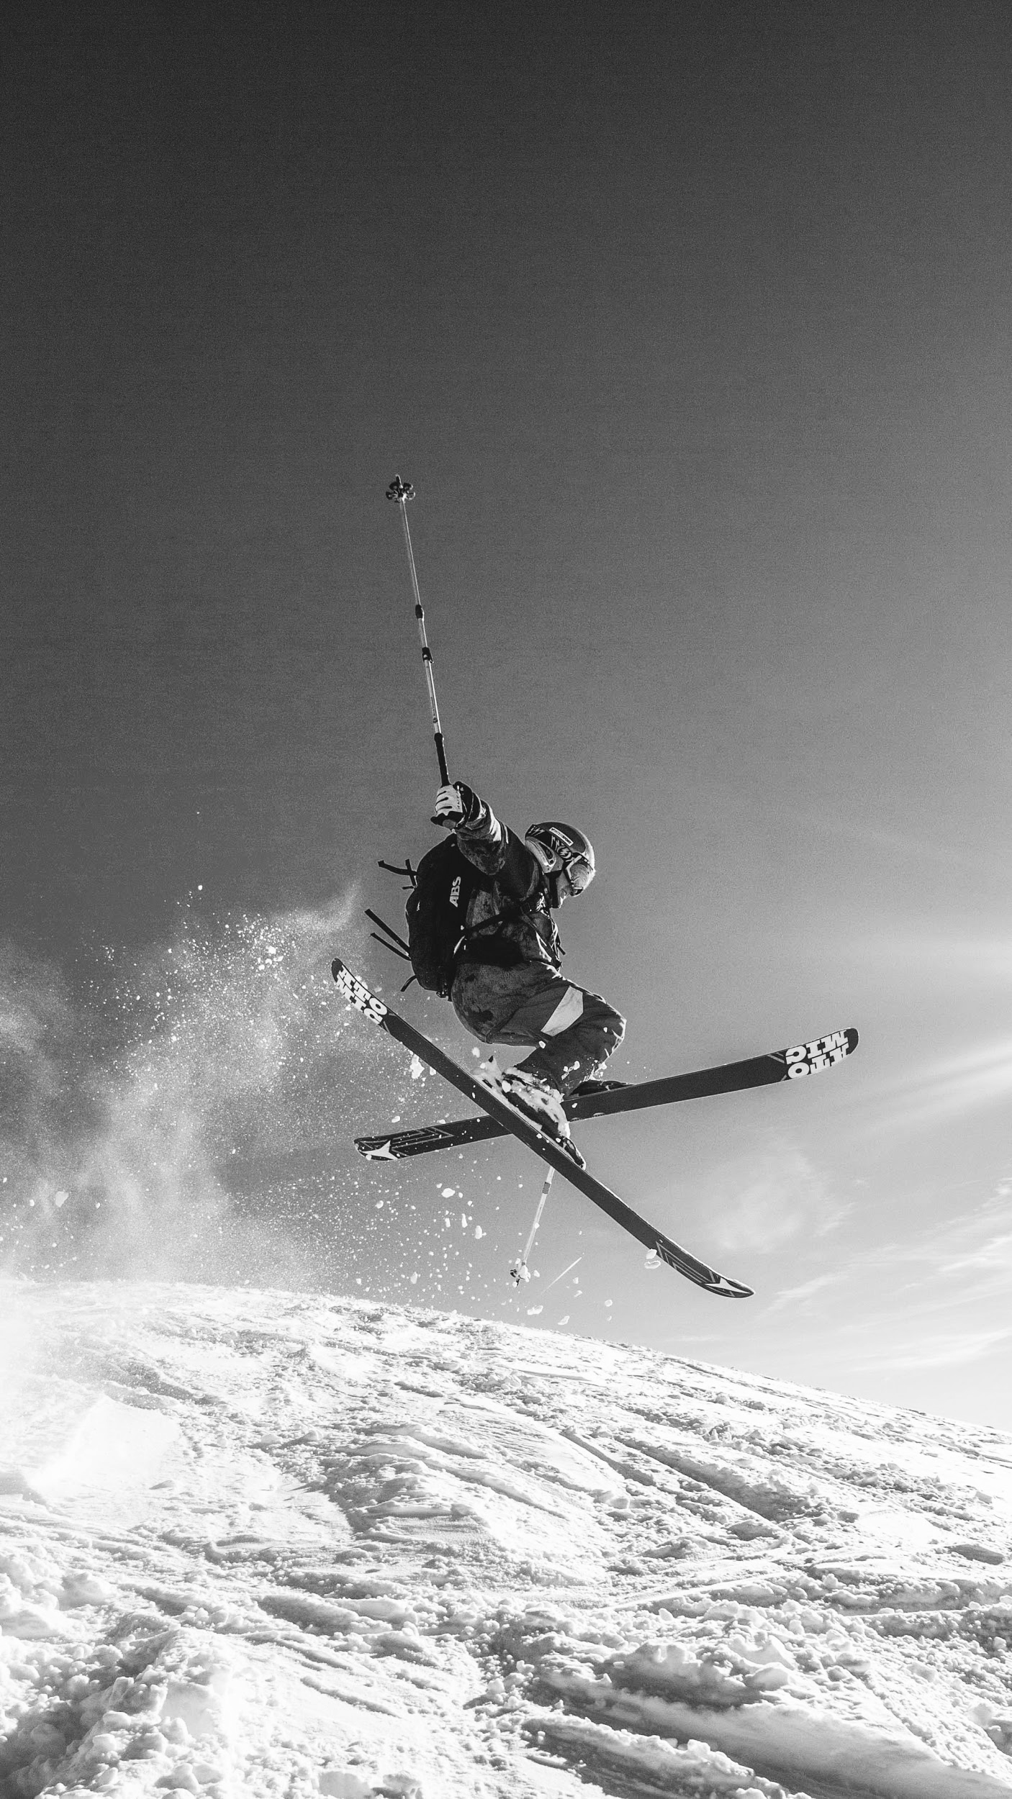
Big Mountain Problem
Recently, Big Mountain Resort added one more chair lift (12 total) to increase access to the mountain for skiers.
The increased operating cost of the chair lift is $1,540,000 for the season. Investors would like to maintain the current 9.2% profit margin.

Slide 3


Recommendation
Big Mountain Resort should increase their Adult Weekend Price to $88.78.
Big Mountain Resort's current Adult Weekend Price is: $81.00.
The suggested price is an increase of $7.78 (or 8.76%) compared to the current weekend price.
This price recommendation was predicted using a machine learning linear regression algorithm to analyze and compare data from 330 similar USA ski resorts across 17 variables. This price prediction was found with 92.39% accuracy.

Slide 4
Estimated Impact If the recommendation is followed, there will be a $778,000 increase in WEEKEND revenue over the ski year.

Slide 5
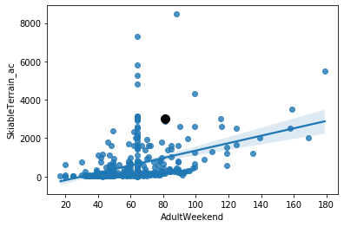
Compared to the other 330 resorts analyzed, Big Mountain Resort has a proportionately high amount of skiable terrain compared to the price of an Adult Weekend Lift Ticket.
This suggests that there is some leeway to increase the price as skiable terrain is a real factor in the overall value offered to customers.
Fig. 1
Black Dot = Big Mountain Resort

Slide 6
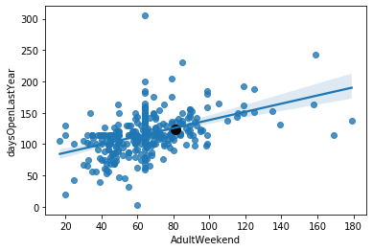
Comparison with competing ski resorts, demonstrates Big Mountain Resort’s Adult Weekend current price is appropriate considering the number of days open last year.
The suggested increase in price to $88.78 would also be within range.
Fig. 2
Black Dot = Big Mountain Resort

Slide 7
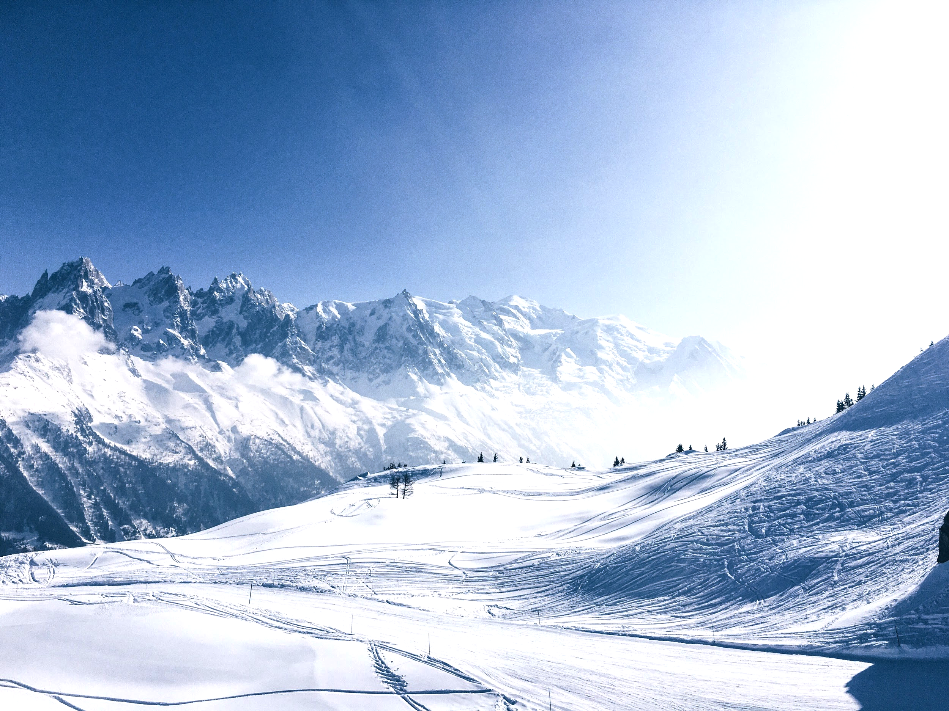
Summary
Considering Big Mountain Resort’s increased operating cost of $1,540,000 for the season and the investors’ expectations to maintain a 9.2% profit margin:
Big Mountain Resort should increase their Adult Weekend Price to $88.78.
The suggested price is an increase of $7.78 (or 8.76%) compared to the current weekend price.
This would result in a $778,000 increase in WEEKEND revenue over the ski year.

Slide 8
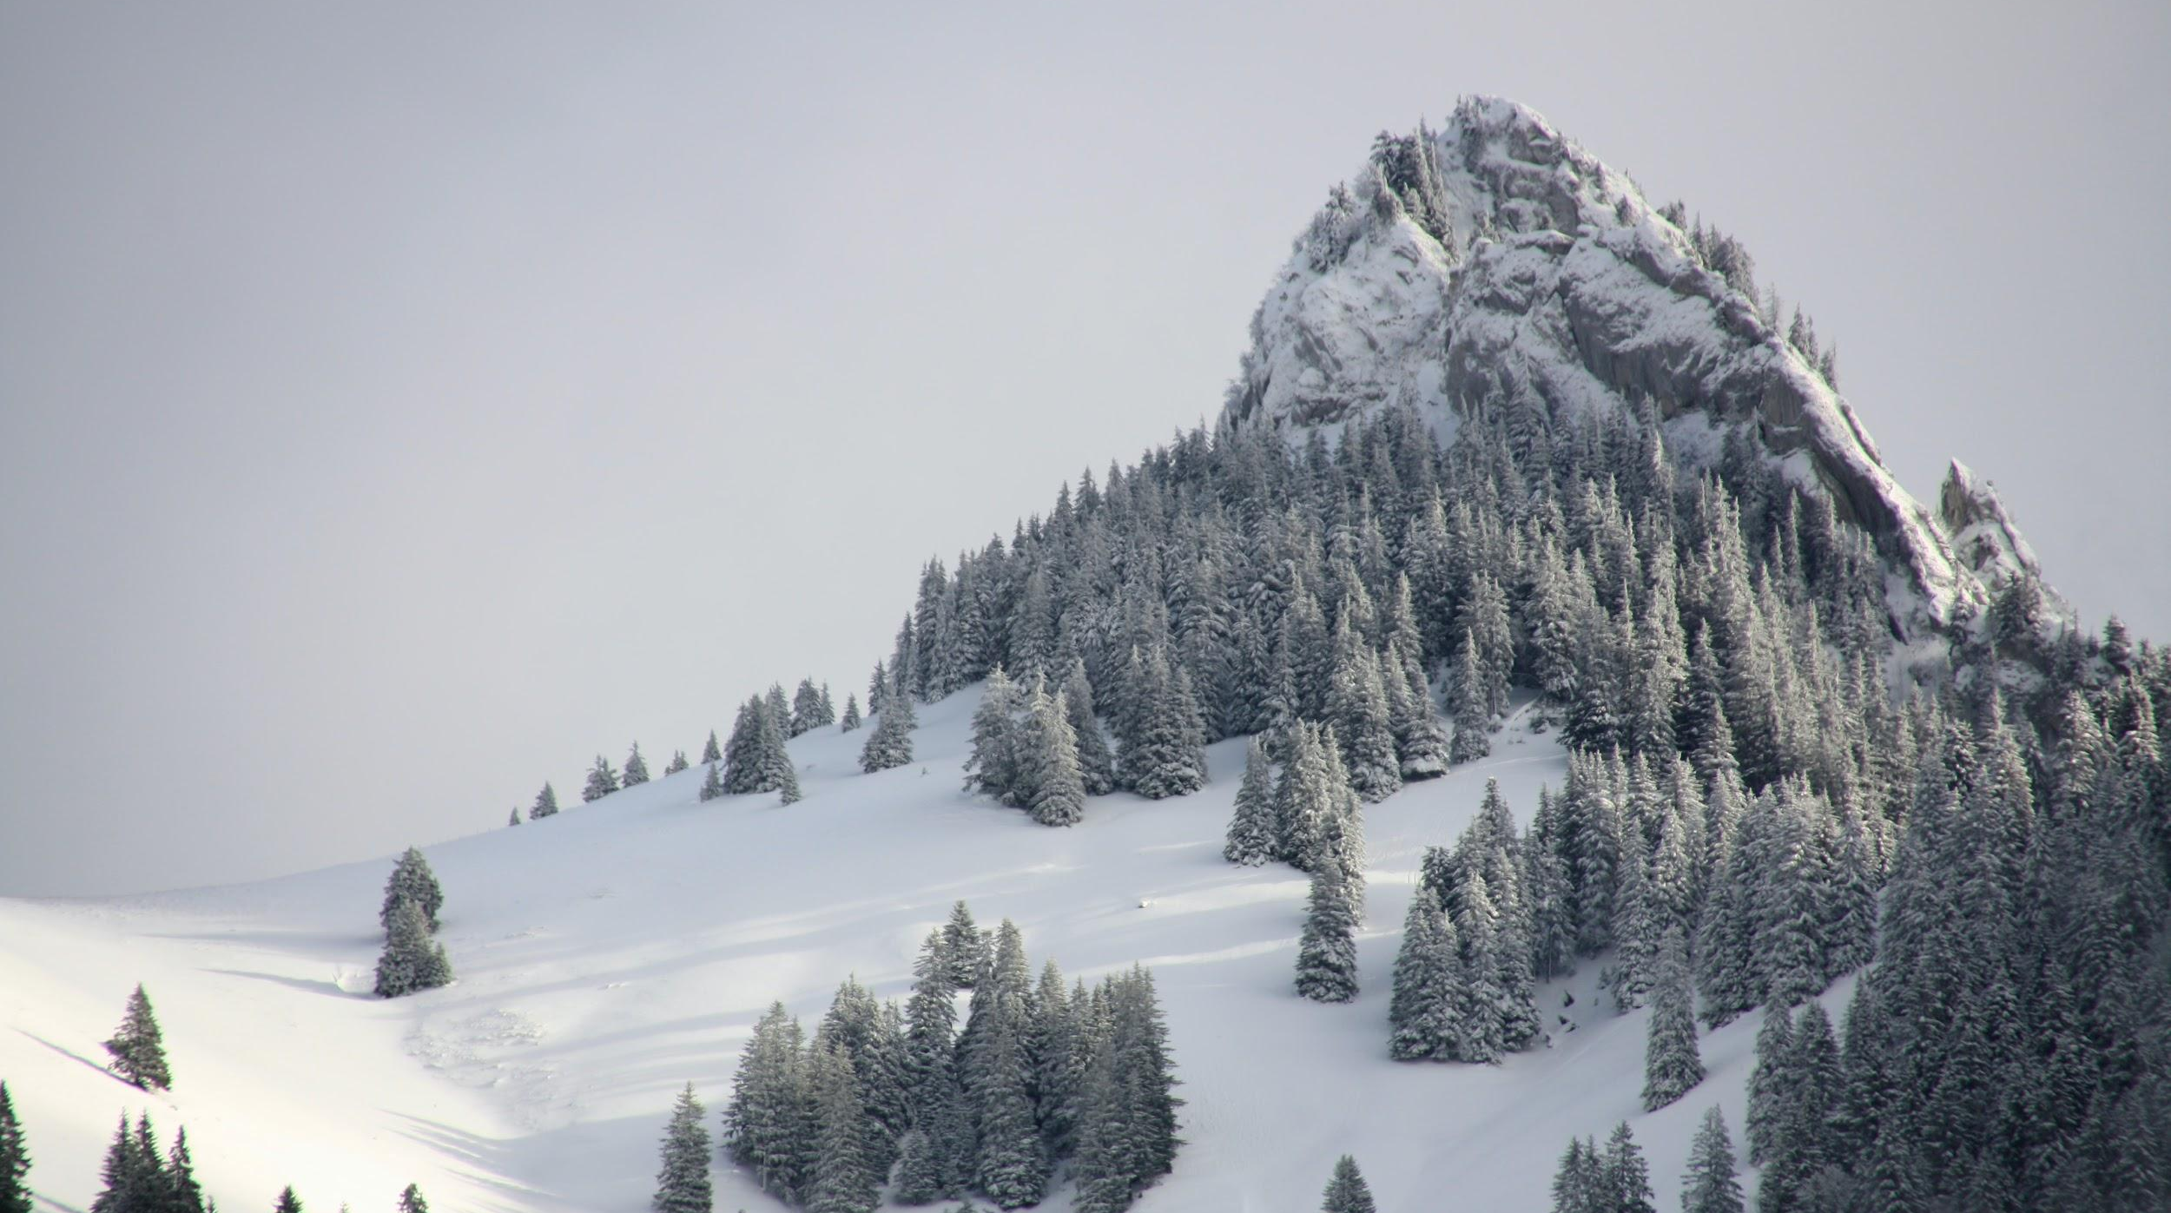
Data
Data from 330 resorts CSV
Process
GitHub Repository:
data, Jupyter notebooks,
exploratory data analysis,
model training/selection,
Prepared by: Prem Ananda
Springboard Data Science
07.12.2020

